Slide 1
Data type of variable
A. Before using a variable.
We must declare it’s data type.
B. One of reasons, for example, our integer and character are same to the machines.

Slide 2
A is the control statement control format for presentation.

Slide 3
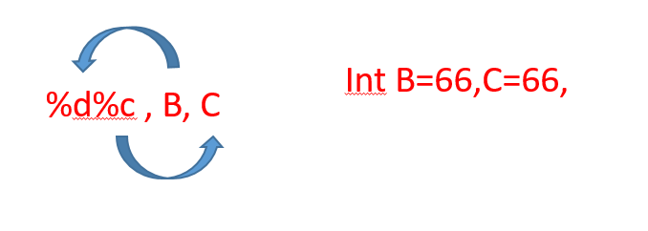
Printf( A, B, C, D)
A is the control statement control format for presentation.
B, C,…..are arguments; No control.

Slide 4
3 Basic blocks of C program
(1) include
(2) Int main() --- main function
(3) Execution statements inside braces

Slide 5
#include < > (1)
(2)Int main {
Printf(“ “); (3)
Return 0;
}

Slide 6
#include < > (1)
(2)Int main {
(3)
for(……………..){
(4)
}
}

Slide 7
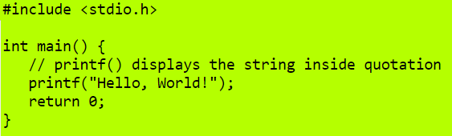
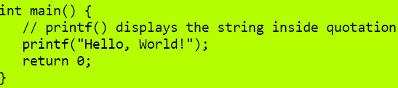


Box1
Box2
Box3
Box3

Slide 8
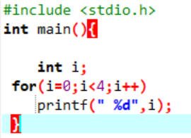
Types(類型) of execution statements
execution statements like printf
Logical statement like if…else
Looping statement like for( )
(1) execution scope by braces
(2) execution statements inside braces
will be executed for each iteration
by the indexing variable
(4) looping condition , if true then continue
(5) looping update, EX: i++
EX: i++ meaning to increase 1 for each loop

